Slide 1
An Introduction to the National Audit Office

Slide 2
Contents
Overview
This section covers the role of the NAO and the Comptroller and Auditor General; the impact of the NAO’s work; the accountability process; and who our work is produced for.
Our work
This section explains the different aspects of the NAO’s work in detail.
Our governance
This section details the NAO’s governance and leadership structures.
Other corporate information
Further information about our outputs, our people and accreditations.

Slide 3
Overview

Slide 4
Our role
The National Audit Office (NAO) scrutinises public spending for Parliament
We help to hold government departments and the bodies we audit to account for how they use public money
Our work helps public service managers to improve performance and service delivery, nationally and locally

Slide 5
Our impact
Our public audit perspective helps Parliament hold government to account and improve public services.
Our work leads to savings and other efficiency gains worth many millions of pounds: £1.1 billion in 2013

Slide 6
The Comptroller and Auditor General (C&AG)
Sir Amyas Morse KCB was appointed in June 2009, and leads the NAO.
He is an Officer of the House of Commons and was appointed by the Queen.
He has statutory access and reporting rights.
He and his staff are totally independent of government.

Slide 7
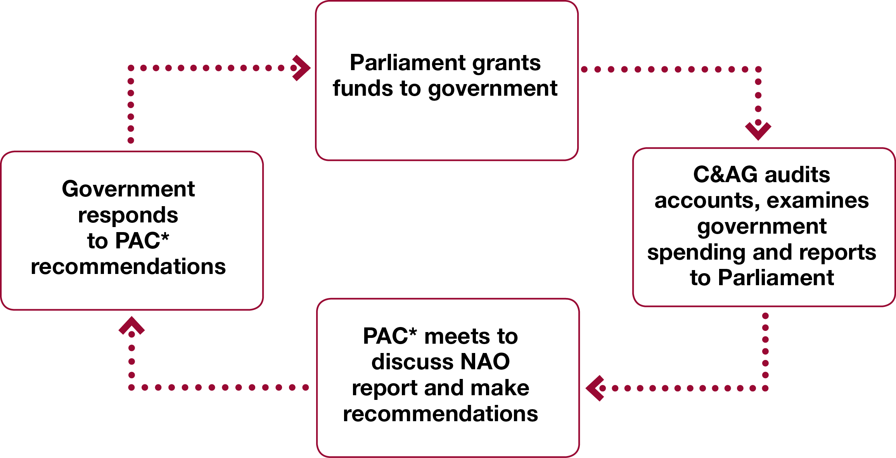
The accountability process
* Committee of Public Accounts

Slide 8
Our work is produced for
The Committee of Public Accounts (PAC)
Other select committees, including the Public Administration Select Committee, Environment, Health, Transport, etc.
All MPs and peers
Senior officials in government departments
Members of the public and groups interested in aspects of our work
Notes:
The Committee of Public Accounts (PAC)
Select Committee of the House of Commons
Chaired by an Opposition MP
Evidence session based on C&AG’s report
Questions put to Accounting Officer
Reports and makes recommendations
Sessions last 1-2 hours
Investigative style
Designed to be formidable
Government must respond to PAC report
Treasury Minute

Slide 9
Our work

Slide 10
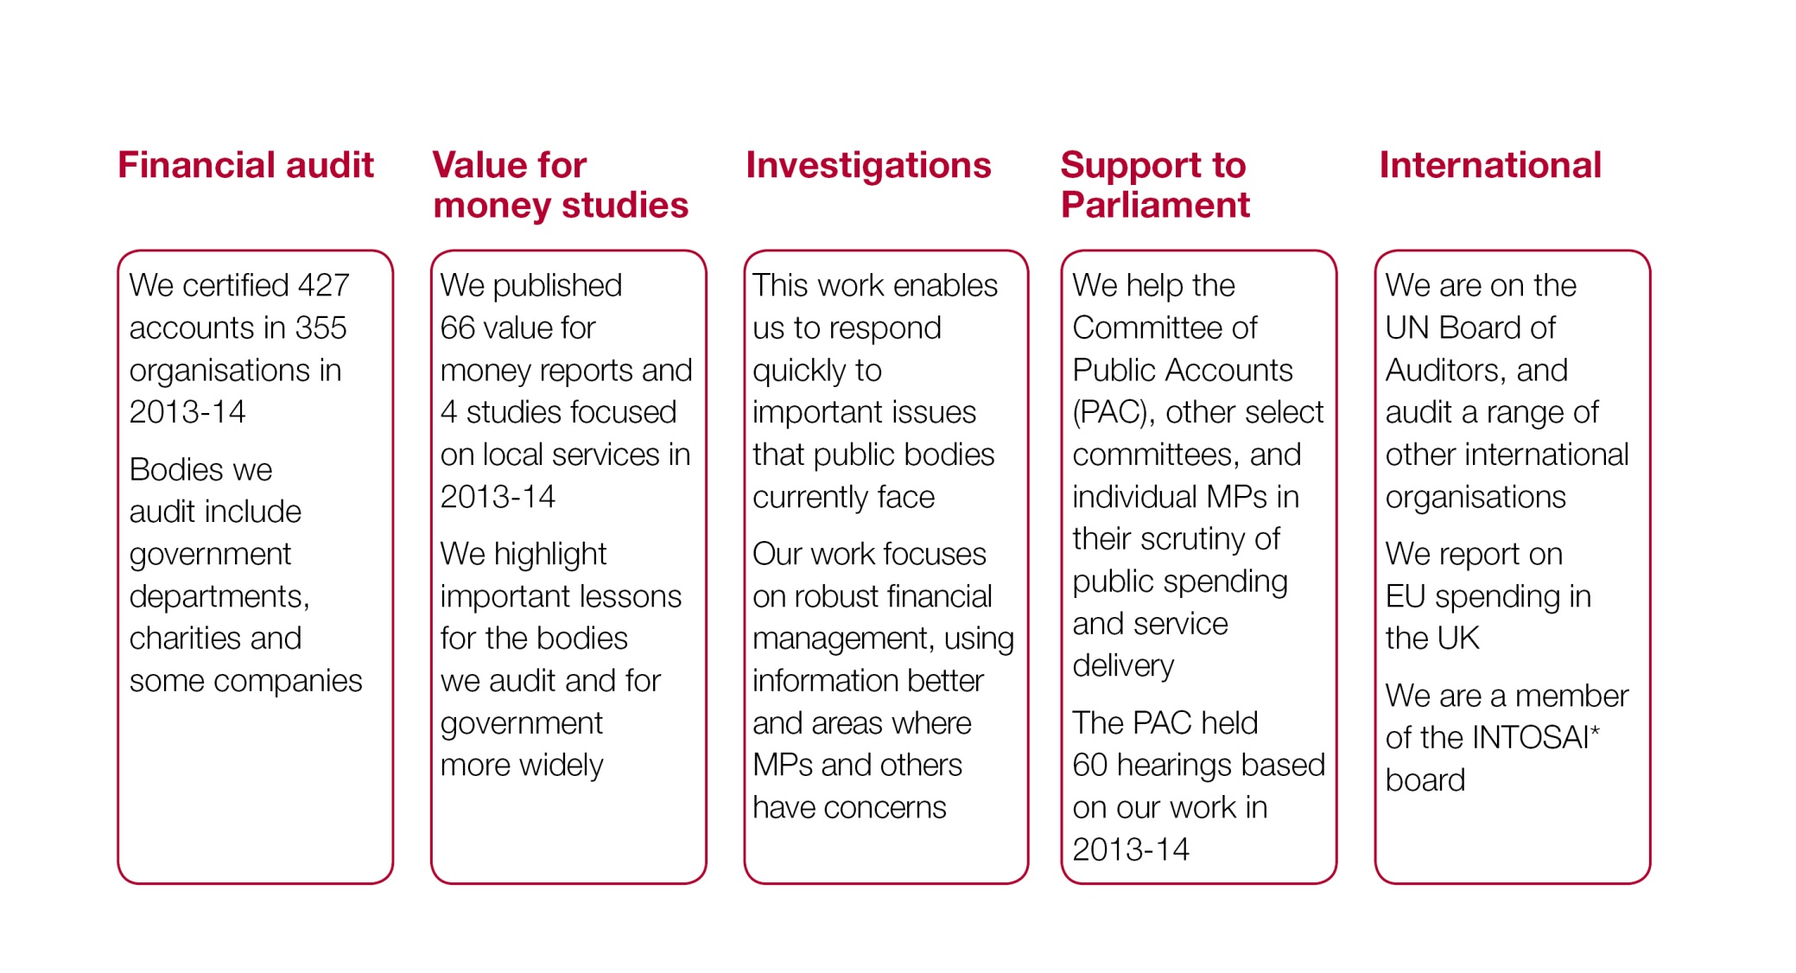
There are five dimensions to our work
* International Organisation of Supreme Audit Institutions
Notes:
Audited bodies include:
Departments - e.g. Health, Defence
Agencies - e.g. Highways Agency
NDPBs - e.g. Environment Agency, Competition Commission
Charities – e.g. British Council, V&A
Companies – e.g. School Food Trust

Slide 11
Audited bodies
The C&AG certified 427 accounts in 2013-14, covering more than £1 trillion of public income and expenditure
Departments e.g. Health, Defence
Agencies e.g. Highways Agency
Arm’s-length bodies e.g. Environment Agency, Competition Commission
Charities e.g. British Council, V&A
Companies e.g. Historic Royal Palaces Enterprises Ltd
Notes:
Source: NAO Annual Report & Accounts 2012-13

Slide 12
Financial audit
The NAO provides an independent opinion ensuring accounts are:
'true and fair'
properly prepared – in accordance with the relevant Accounting Framework
regular – income or expenditure, or both, in line with Parliamentary intention
Notes:
Accounting Framework’ = This is a set of rules and guidelines issued by Treasury which sets out how central government should prepare its annual report and financial statements. This is based on International Financial Reporting Standards, altered to be more specific to the circumstances of government.
‘Parliamentary intention’ = When a body is established, the legislation will set out what activities it can expend its resources on. This is parliamentary intention.

Slide 13
Financial audit approach
The NAO approach:
complies with International Standards on Auditing (ISAs)
is a risk-based audit approach
focuses on material matters, i.e. matters which could alter the user’s understanding of a set of financial statements
Notes:
‘risk based audit approach’ = Our audit planning seeks to ascertain what risk there is of material fraud or error arising in an account. This drives the level of work we do beyond the minimum required by international auditing standards. We also consider the level of media and public interest in the account.

Slide 14
Financial audit outputs
Audit opinion on financial statements
The C&AG gives an opinion on financial statements, including whether they are true and fair. For most of the accounts we audit, the C&AG will also give a regularity opinion.
C&AG's report on accounts
The C&AG may choose to issue a substantive report on an entity which he audits. These are used to bring Parliament's attention to matters which have a direct or indirect effect on public expenditure.
Letter to management
The letter recommends process and control improvements.
Notes:
‘qualified’ = a qualified opinion is given when audit work indicates that an account is not true and fair in all material respects. This will usually be isolated to a specific area of an account, although can be broader.
‘regularity opinion’ = This is similar to parliamentary intention. Our audit testing seeks reasonable assurance that expenditure has been incurred in line with parliamentary intention. Any expenditure which is not is deemed to be irregular and a qualified opinion on regularity is given.

Slide 15
Value for money audit (VFM)
Parliament uses our reports to hold government to account for how it spends public money
We cover a wide range of significant topics, such as the NHS and major defence projects, and increasingly focus on local services, including those delivered by local government
We select our studies based on a detailed assessment of risks to value for money, with input from PAC and Parliament

Slide 16
Value for money audit (VFM)
Our reports highlight important lessons for the bodies we audit and for government more widely
We do not comment on the merits of policy but aim to conclude on whether value for money has been secured

Slide 17
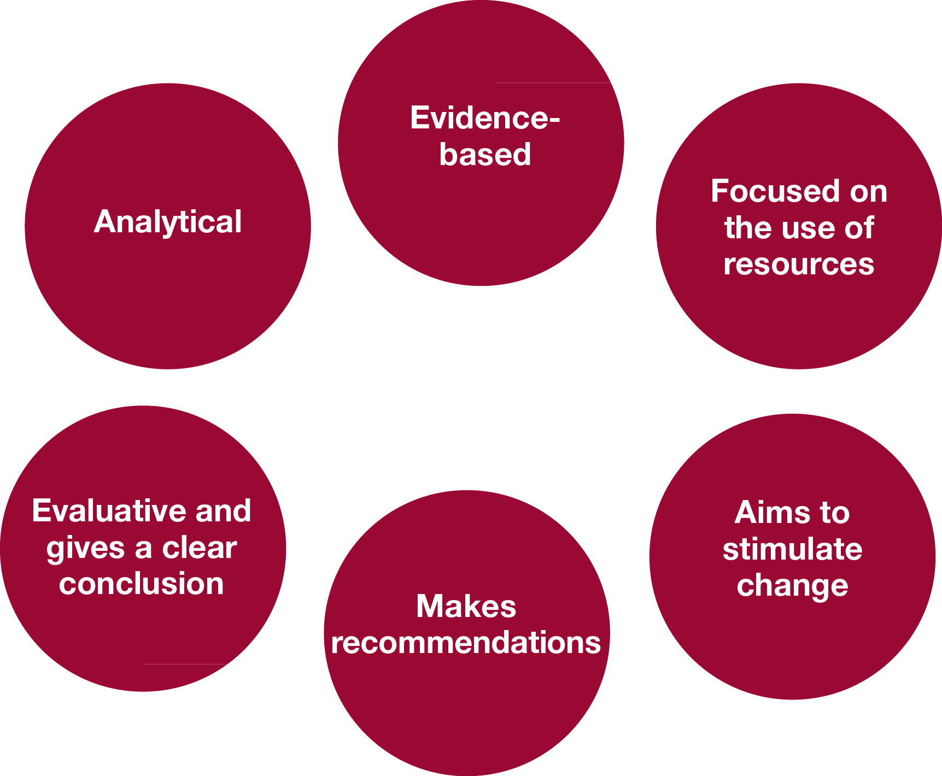
What is VFM audit?
Notes:
Evidence based: we must be able to substantiate what we say with documentary and other proof;
Analytical: we must be able to derive meaning from our examination of the evidence. VFM work is not just evidence gathering;
Resource focused: we are an audit office and people expect to see us reporting on how public money and public assets have been used;
Evaluative: we must conclude and make judgments in our work, rather than just be descriptive;
Prescriptive: having concluded we must design recommendations to assist our clients to improve aspects of their business; and
Purposeful: we do not undertake studies for their own sake but rather to support accountability processes and to stimulate change.
What do we mean by VFM audit?
VFM audit is a hybrid activity which has evolved over the years to incorporate aspects of a number of other disciplines. It has moved some way from traditional audit, although at heart our approach to evidence and our concern for how public money has been spent demonstrates that we remain auditors. VFM work is not research for its own sake, although we do draw on the work of academic research. Nor is it management consultancy, which is not necessarily so evidence based, although we do make recommendations for change.

Slide 18
Confirming the accuracy of our reports
The C&AG has complete discretion over the content of our reports
We agree the factual accuracy of our reports with the bodies we audit but not the conclusions and recommendations
We also seek comments from other parties mentioned in our reports
The aim is to ensure subsequent debate focuses on lessons to be learned, with the facts agreed

Slide 19
Investigations and insight
We carry out investigations into areas of concern raised with us by Members of Parliament or members of the public. In 2013-14 this work included:
Confidentiality clauses and special severance payments;
The Ministry of Justice’s electronic monitoring contracts; and
Government whistleblowing policies.

Slide 20
Investigations and insight
We also provide in-depth analysis into the systemic issues faced across government, including:
the effective use of information and ICT; and
good practice in financial management.

Slide 21
Support to Parliament
We place our skills at the service of Parliament as a whole, supporting in particular the Committee of Public Accounts (PAC), other select committees from both Houses and individual MPs in their scrutiny of public spending and service delivery.

Slide 22
Our international role
We sit on the UN Board of Auditors
We carry out external audits of a range of other international organisations
We report on EU spending in the UK
We are a board member of the International Organisation of Supreme Audit Institutions
We provide capacity-building support to Supreme Audit Institutions and parliaments abroad
Notes:
Examples of international bodies we audit: Advisory Centre for World Trade Law, UN High Commissioner for Refugees
Source: NAO intranet

Slide 23
New areas of work
The NAO has taken on new responsibilities:
auditing organisations in the reformed financial regulatory system, such as the Financial Conduct Authority;
auditing probation trusts across England; and
developing local government work, including preparations to take on new responsibilities for overseeing the Code of Audit Practice
Notes:
Financial Regulatory bodies: From April 2013 we began to audit bodies in the new financial regulatory framework, including the Financial Services Compensation Scheme, the Financial Ombudsman Service, the Money Advice Service, the Prudential Regulation Authority and the Financial Conduct Authority.
Local government: The passage of the Local Audit and Accountability Act 2014 has implications for our VFM audits. The Act gives the C&AG’s power to undertake work regarding the economy, efficiency and effectiveness with which local public bodies have used their resources. In 2013-14, we began this work with a small number of separately funded VFM audits considering local services. Examples include our reports on council tax support, funding and structures for local economic growth, financial sustainability of local authorities, and central government’s communication and engagement with local government.
Probation trusts: In 2012-13, the C&AG became responsible for auditing 34 English probation trusts. We worked with trusts and sector organisations to develop the framework for our audit. We identified innovative approaches to streamline the audit process, making a ten per cent reduction in audit fees to trusts this year, compared with previous arrangements. The sector welcomed our approach, which has helped to build our credibility as an auditor for local public service bodies.

Slide 24
Our governance

Slide 25
NAO board members
Non-executive members
Professor Sir Andrew Likierman Chairman
Gillian Guy Chair of the Audit Committee
Paula Hay-Plumb Senior independent board member and Chair of the Remuneration and nominations committee
Naaz Coker
Dame Mary Keegan
Executive members
Amyas Morse Comptroller and Auditor General
Michael Whitehouse Chief Operating Officer
Gabrielle Cohen Executive Leader (stakeholder relations)
John Thorpe Executive Leader (economic affairs)

Slide 26
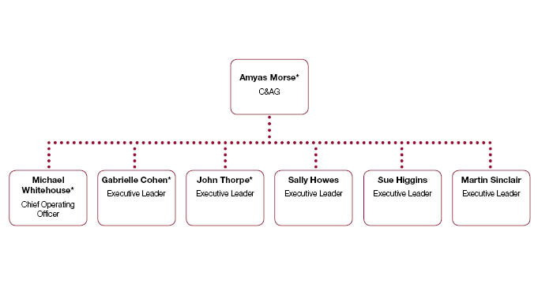
NAO leadership team
* Board member

Slide 27
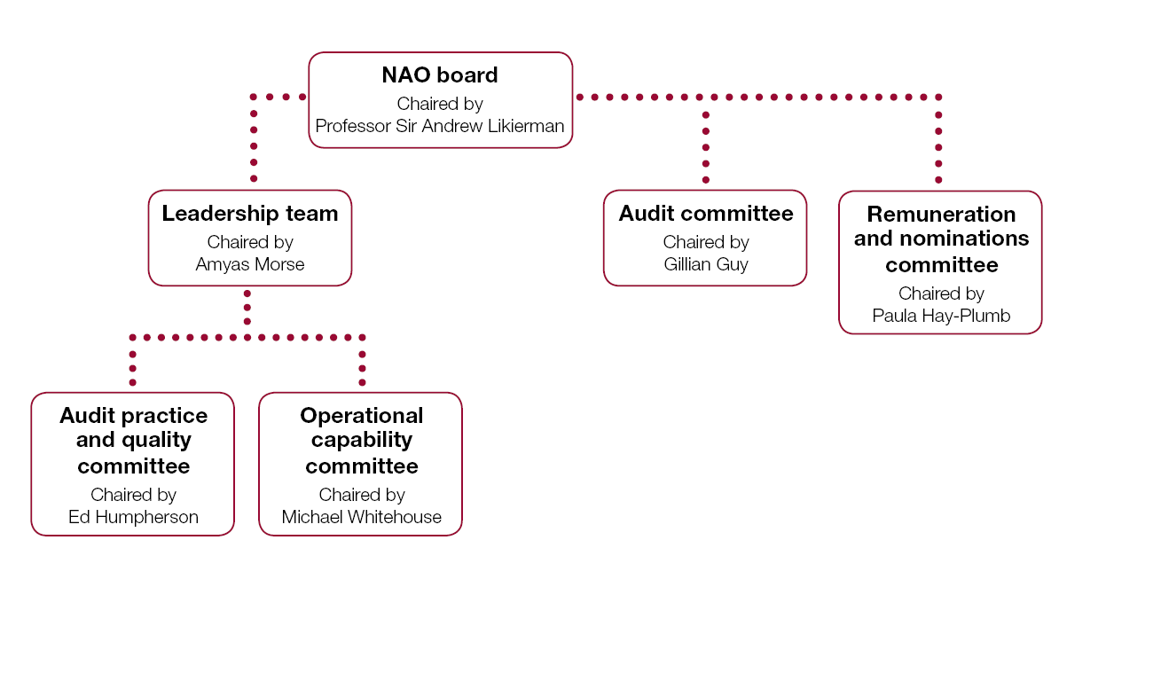
Governance
Notes:
Effective governance is vital to the success of an organisation. We aim to practise what we preach by upholding high standards of governance in our operations and decision-making

Slide 28
Who audits the NAO?
The Public Accounts Commission, a committee of MPs
Approves our budget
Scrutinises costs and performance
Appoints our external auditors
Commissions value-for-money studies of our work

Slide 29
Other corporate information

Slide 30
Key corporate data
Notes:
Source: NAO Annual Report and Accounts 2013-14
NAO helps the Ministry of Defence to improve inventory management In our financial audit work for the opinion on the 2013 Ministry of Defence financial accounts, we identified £70 million net book value of Bowman radio raw materials and consumables, and £18 million of capital spares which were not visible on the base inventory systems and had not been accounted for in the financial statements. The Ministry of Defence corrected this financial error.
Impact: In response, the Ministry of Defence also amended the manual process that had been suppressing the balances from feeding to the accounts, allowing visibility of this stock to inventory managers and, in turn, improved inventory management.

Slide 31
Our people
Accountants
Statisticians
Economists
Social scientists
Technical specialists
Client specialists

Slide 32
Our role in the accountancy profession
We sit on the following boards and councils:
HM Treasury’s financial reporting advisory board
On CIPFA* and ICAEW** councils
ICAEW financial reporting committee
* Chartered Institute of Public Finance and Accountancy
** Institute of Chartered Accountants in England and Wales
Notes:
Source: VFMPQ June 2012

Slide 33
Accreditations
We are ranked 158th in the Guardian’s list of the top 300 employers that students most want to work for.

Slide 34
Further information
NAO website www.nao.org.uk
Follow the NAO on Twitter @NAOorguk
Sign up for email alerts with NAOdirect
NAO videos on YouTube
NAO Annual Report & Accounts 2013-14
Public Accounts Commission

