Slide 1
An introduction to the NAO Strategy 2014-15 to 2016-17

Slide 2
We have been successful in delivering our strategy so far
In 2012, our work helped government save nearly £1.2 billion
We are on track to reduce our costs by 15% over the three years to 2013-14
In 2012-13 government bodies accepted 82% of the Committee of Public Accounts’ recommendations
An independent survey of MPs shows they hold us in high regard and our work is often cited in Parliament

Slide 3
Our strategic objectives remain the same

Slide 4
The environment is changing
The government has forecast continued reductions in departmental spending
Austerity
Reforms are being introduced at pace, often using innovative approaches
Reform
The civil service needs to manage extensive change and provide quality services with fewer resources
Capability
Local delivery
Local bodies must provide more for less, while demand for many local services continues to increase

Slide 5
We are responding these changes by transforming the way we work
In 2014 we will:
Provide a clearer focus on strategic issues shared across government
Integrate our assurance to Parliament
Improve our investigative capability
Increase our skills and expertise in key areas

Slide 6
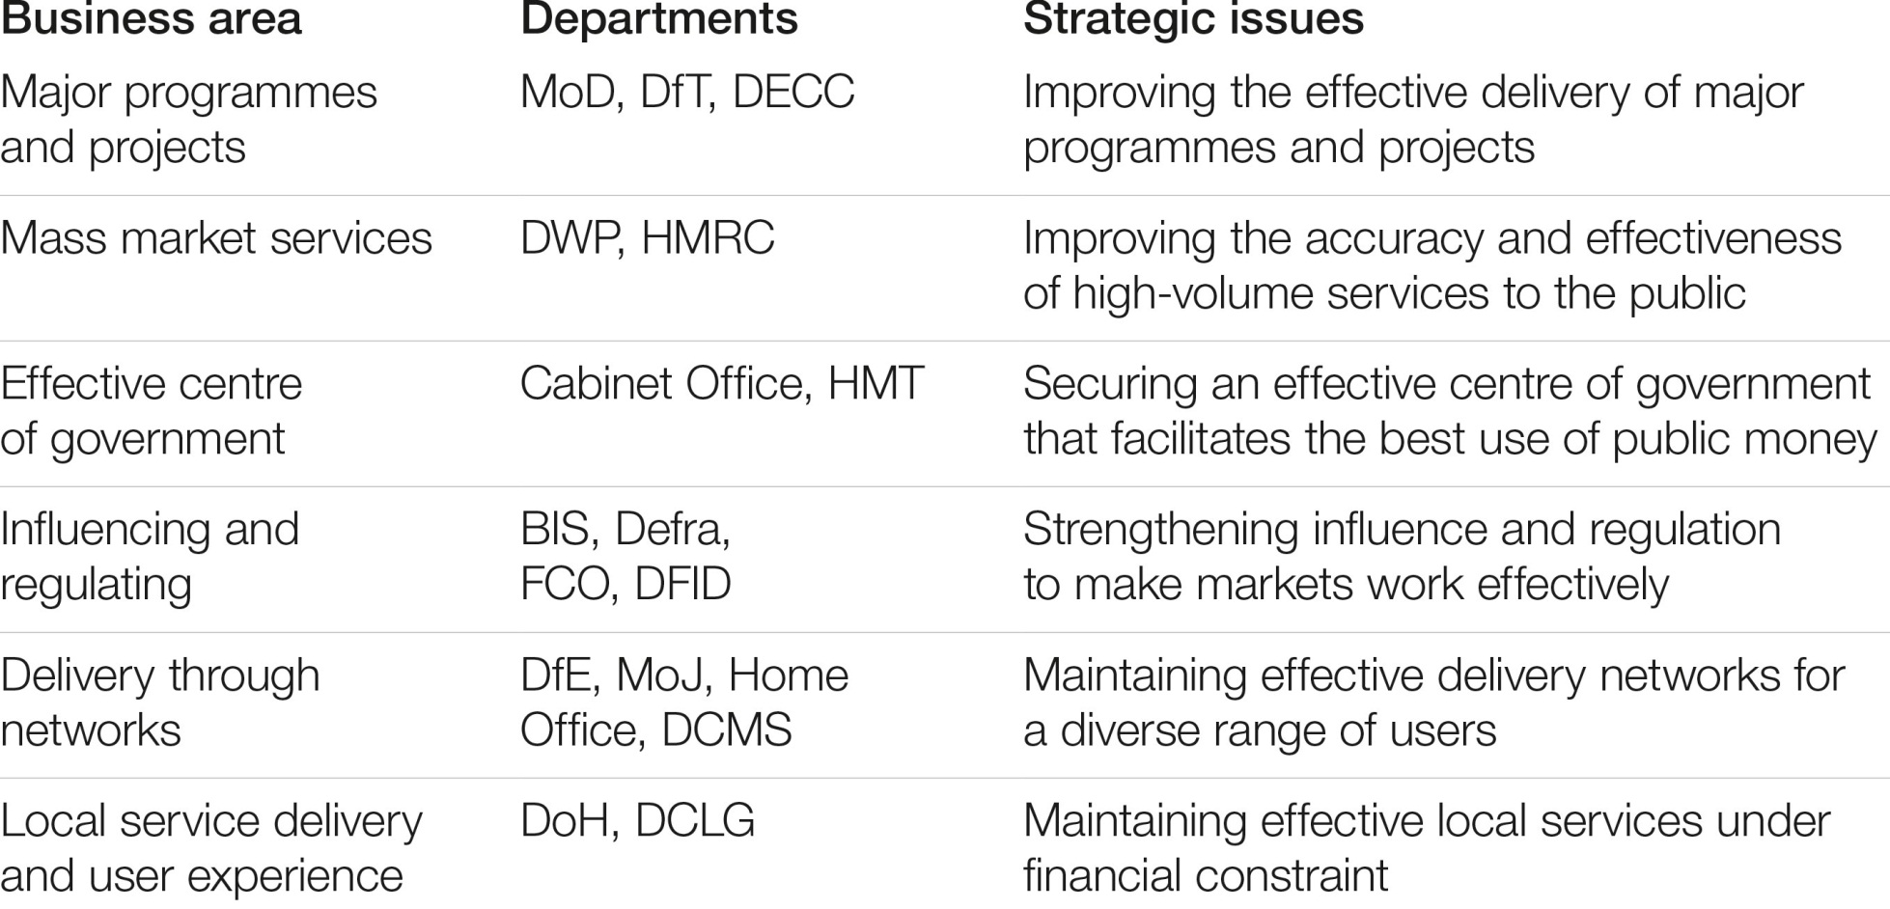
Shared strategic issues
We have created ‘clusters’ of teams that will develop deep expertise in these issues:

Slide 7
We are refining how we measure and monitor our performance
Our new performance framework will focus on:
The extent to which we achieve financial and wider impacts;
Our corporate efficiency; and
How far we can influence improvement in shared strategic issues

Slide 8
We will do more work in certain areas
We will increase the amount of resources allocated to investigative work
In 2014-15 we will increase the number of local government studies we produce, and thereafter publish six per year
We will develop our expertise in the key strategic issues

Slide 9
Outcomes
We are drawing on our strengths and developing new capabilities
We will be able to respond quickly to complex, fast-moving public sector issues
Our products will be targeted and relevant
We will have the right mix of skills and experience to address key strategic issues in the public sector

Slide 10
Further information
NAO website www.nao.org.uk
Follow the NAO on Twitter @NAOorguk
Sign up for email alerts with NAOdirect
NAO videos on YouTube
NAO Annual Report & Accounts 2012-13
Public Accounts Commission

