Slide 1
National Audit Office Annual Report and Accounts 2013-14

Slide 2
Welcome
The National Audit Office (NAO) scrutinises public spending for Parliament. Our public audit perspective helps Parliament hold government to account and improve public services.
We published our Annual Report and Accounts 2013-14 on 9 June 2014.
To find out more about our achievements last year, read on…

Slide 3
Contents
Our objectives
Focusing on strategic issues
Our achievements
Our impacts
Our feedback
NAO cost reduction
Find out more

Slide 4
Our objectives
Our vision is to help the nation spend wisely. To achieve this, our objectives are:
to develop and apply our knowledge by building our expertise and focusing on the strategic issues that public bodies face;
to increase our influence on the key challenges faced by government and the way that policies are implemented; and
to deliver high performance by transforming the NAO and practising what we preach.

Slide 5
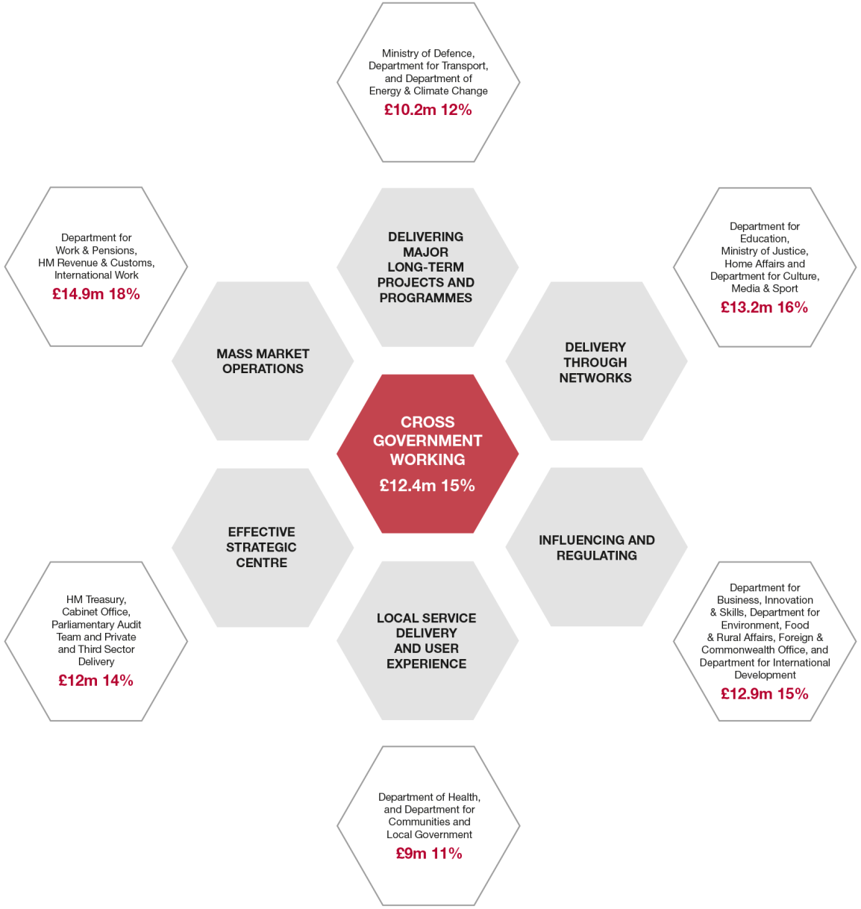
Focusing on important strategic issues
This diagram shows the distribution of National Audit Office resources in 2013-14
We cluster our activities by department, and focus our resources on the important strategic issues faced across public services. We deliver a comprehensive programme of work, providing insight and supporting accountability for the use of public funds.

Slide 6
The NAO has achieved a lot in 2013-14
We certified 427 accounts in 355 organisations, assuring more than £1 trillion of public income and expenditure.
We published 66 value for money reports on a range of government activity and 4 studies focused on local services, providing Parliament with insight on how public funds are used.
Our work helped Parliament. The Public Accounts Committee held 60 hearings based on our work in 2013-14.

Slide 7
Our work has achieved impact across the public sector
86 per cent
of PAC recommendations were accepted in 2013-14
67 per cent
of the bodies we audit agree that the NAO’s work improves their approach to financial management and control
We estimate that the Department for Work and Pensions has been able to reduce the loss to the taxpayer by £133.3m since 2010-11 due at least in part to our recommendations
We helped government save £1.1 billion in 2013
Our work also helped government identify improvements that they could make to strengthen efficiency and effectiveness

Slide 8
Both Parliament and the bodies we audit value the contribution of NAO staff
Our 822 staff are largely qualified or trainee accountants. We also have a number of specialists in other fields such as statistics, economics, and ICT
We are a training organisation
In 2013-14 we recruited 50 new graduate trainees and 11 school leavers
In 2013 our trainees once again achieved exam results above the national average
“They have been very effective at uncovering the waste of a large amount of public money; their reports are regarded as impartial, authoritative, detailed.”
Conservative backbencher
"They are fantastic. They tell us information that we need when we ask them about it, they are very good at what they do and we get full answers from them.”
Labour shadow minister
"They are independent and they give a fair balanced opinion on whatever the statistics say.”
Liberal Democrat backbencher

Slide 9
Like the bodies we audit, the NAO is making savings
In 2013-14, we achieved a net overall cost reduction of 17 per cent in cash terms (22 per cent in real terms) in the three years since 2010-11
In addition to reducing our costs, we have exceeded our target to focus more than 80 per cent of our resources on front-line activity

Slide 10
Find out more about the work of the National Audit Office in 2013-14 in our Annual Report and Accounts, available at: Follow the NAO on Twitter @NAOorguk Sign up for email alerts with NAOdirect NAO videos on YouTube
www.nao.org.uk

